Slide 1
THE WRITING PROCESS
FOCUS: IDEAS, ORGANIZATION

Slide 2
The Writing Process
The 6+1 Traits of Good Writing can easily be grouped into the steps of the Writing Process.
1) PRE-WRITING: IDEAS, CONTENT
OUTLINING: ORGANIZATION
3) DRAFTING: VOICE
4) REVISING: WORD CHOICE, SENTENCE FLUENCY
5) EDITING: CONVENTIONS
6) FINAL DRAFT: PUBLISHING

Slide 3
STEP 1: IDEAS
Pre-writing involves GENERATING IDEAS and CONTENT.
Here are some GRAPHIC ORGANIZERS to help you generate IDEAS and CONTENT:
Bubble Cluster, Spider Maps, Fishbone Maps | Venn Diagram | T-Chart | Pros/Cons Scale
Cause / Effect Diagrams | 5Ws and H | Sensory Detail Chart | Timeline

Slide 4
IDEAS: Bubble cluster Think: For what kind of writing would this be most helpful?

Slide 5
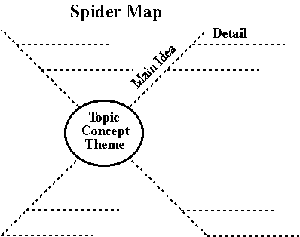
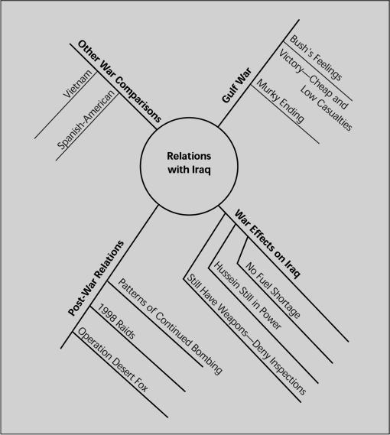
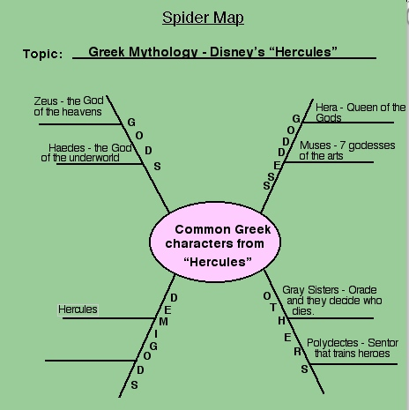
IDEAS: Spider Maps

Slide 6
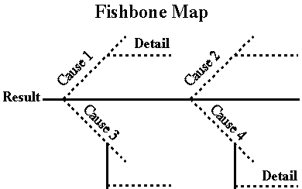
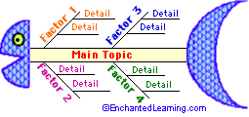
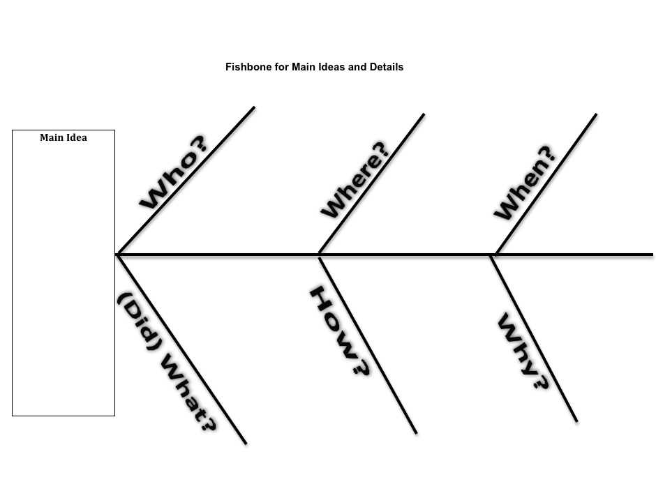
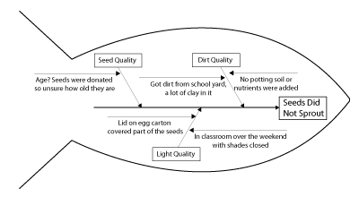
IDEAS: Fishbone Maps

Slide 7
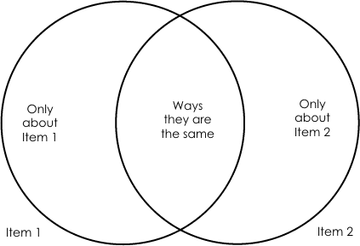
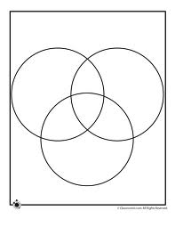
IDEAS: Venn Diagrams Think: For what kind of writing would this be most helpful?

Slide 8
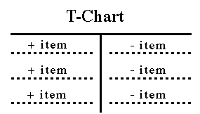
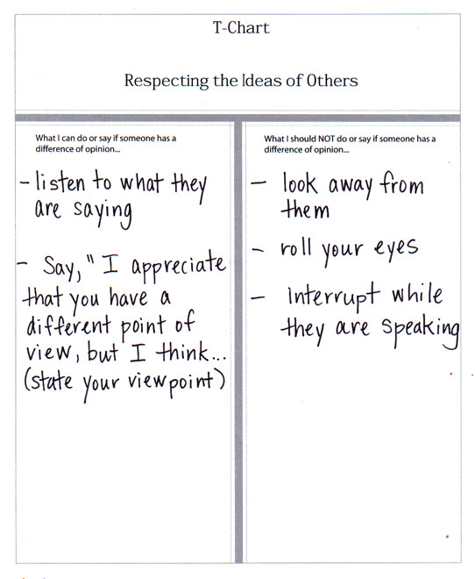
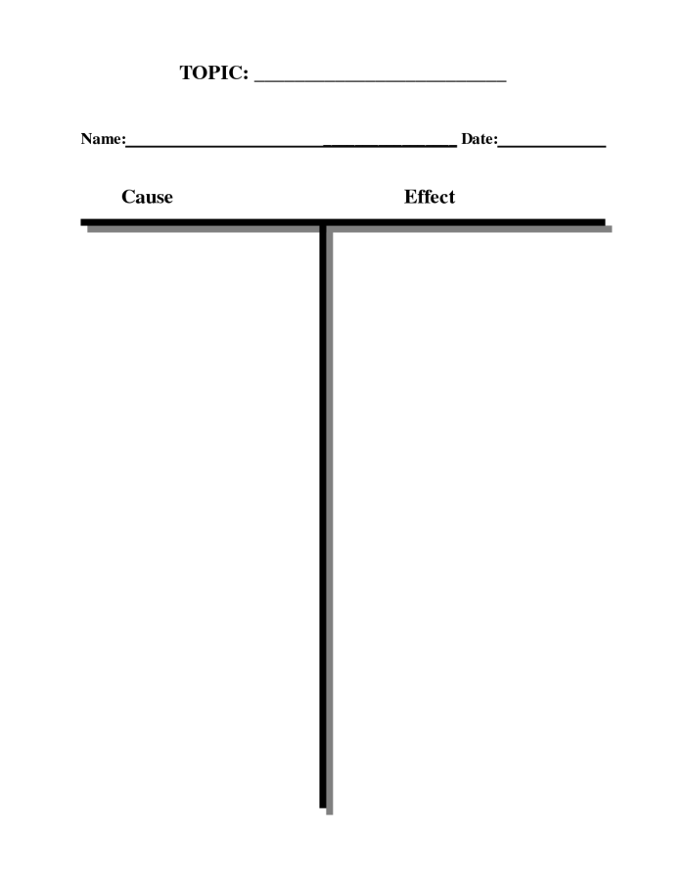
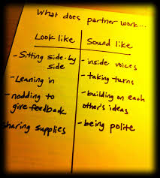
IDEAS: T-Chart

Slide 9
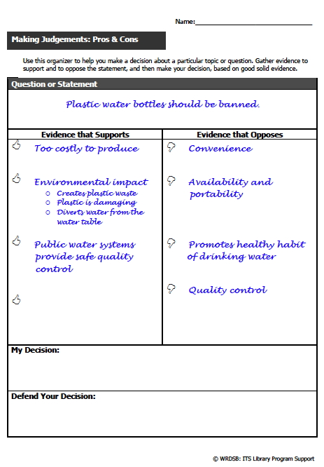
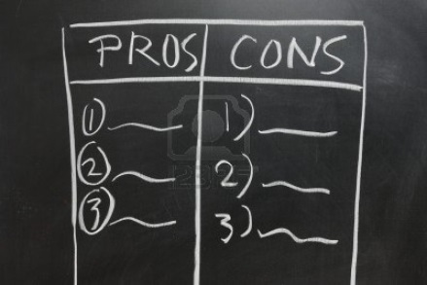
IDEAS: Pros & Cons Scale

Slide 10
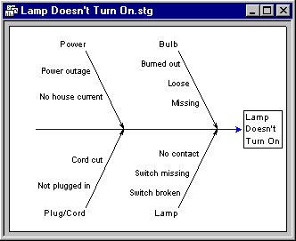
IDEAS: Cause & Effect Diagrams

Slide 11
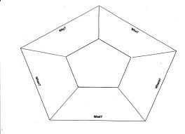
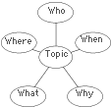
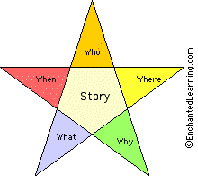
5Ws and H Chart

Slide 12
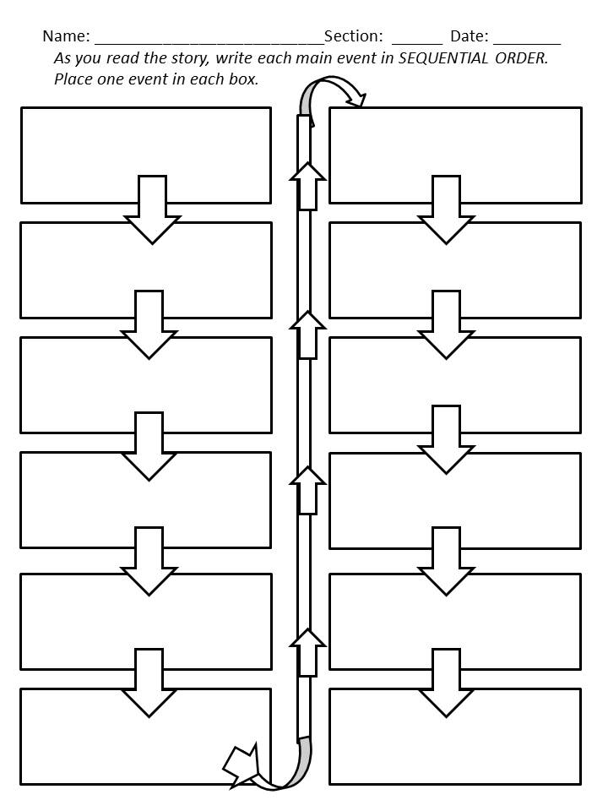
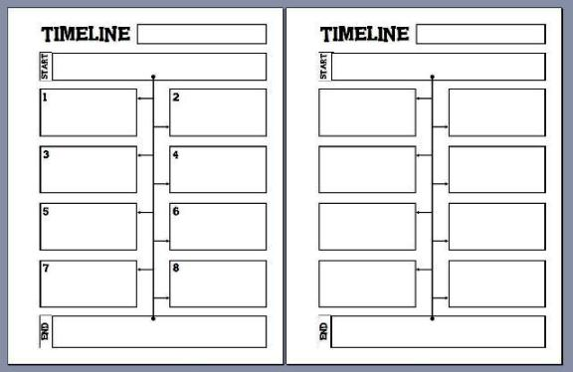
IDEAS: Timeline & Sequential Order Chart

Slide 13
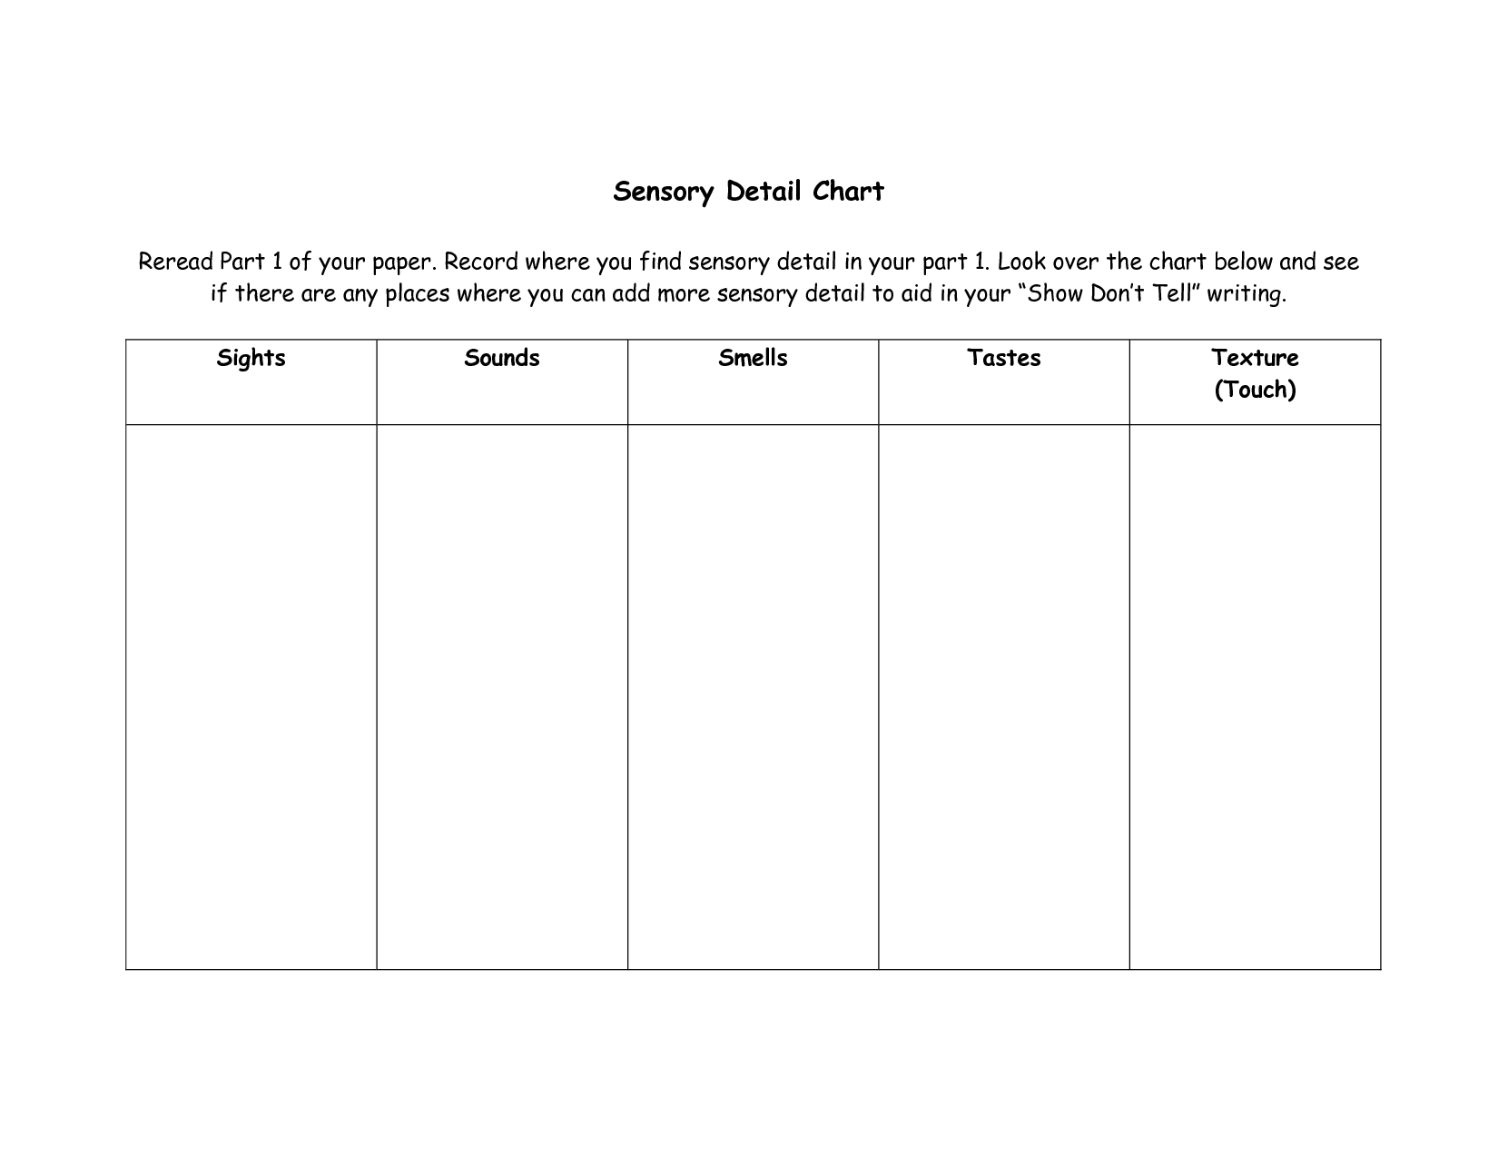
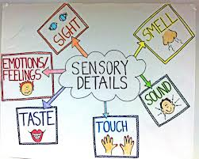
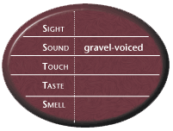
IDEAS: Sensory Detail Chart

Slide 14
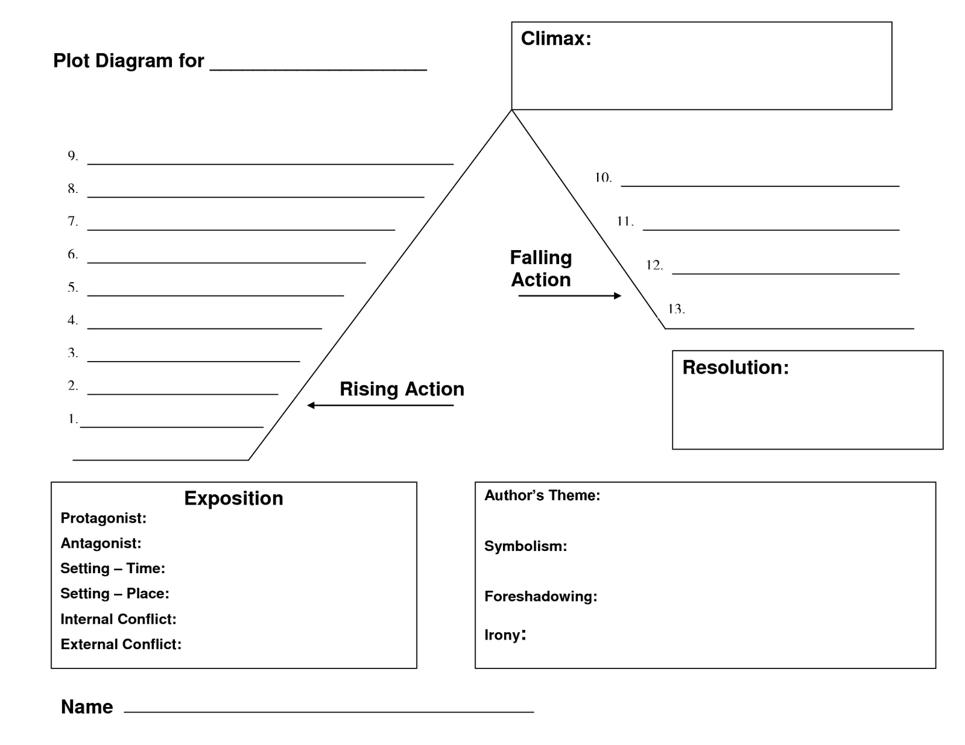
IDEAS: Plot Diagram

Slide 15
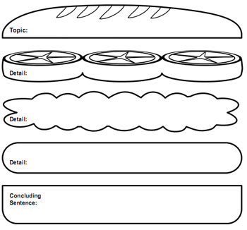
STEP 2 - ORGANIZATION: What is an Essay Outline?
Outlines are how we ORGANIZE our IDEAS.
If we use them effectively, we will organize a nice, orderly information “sandwich”:

Slide 16
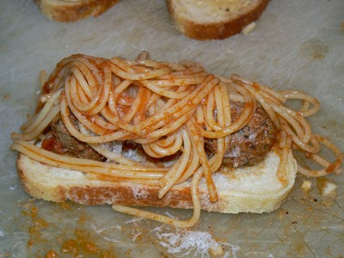
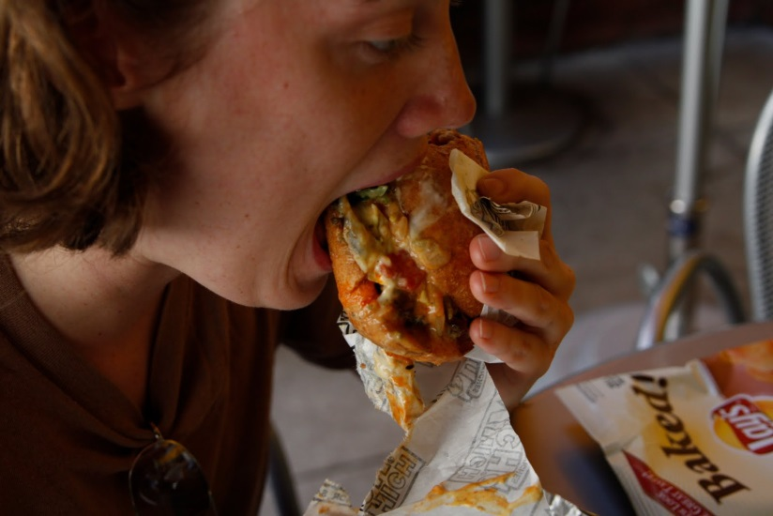
Why is outlining important?
Outlines keep your ideas in order…help you remove what should be removed…
Outlines make conveying your ideas to your reader…
… and help you avoid putting things in that should be out…
…easy for your reader to take in and digest!

Slide 17
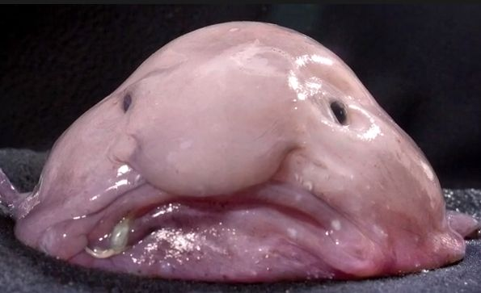
Need another metaphor?
Outlines give structure to your writing just as a skeleton gives structure to your body.
Imagine your body without a skeleton when you imagine creating an essay without an outline!

Slide 18
What does an outline look like?
I. Introduction
“Hook” sentence
Thesis statement – topics 1, 2, 3
Transition
II. Body Paragraph - Topic 1
Topic
Fact
Supporting Detail 1
Supporting Detail 2
Reason – Supporting Detail
Example – Supporting Detail
Detail – Supporting Detail
Transition
III. Body Paragraph – Topic 2
Topic
Fact
Reason
Supporting detail 1
Supporting detail 2
Example
Detail
Transition
IV. Body Paragraph - Topic 3
Topic
Fact
Reason
Detail
Supporting detail 1
Supporting detail 2
Transition
V. Conclusion
Restatement of thesis
Clincher statement

Slide 19
First steps: Reverse Outline
Reverse outlining involves creating an outline from text already written.
It is the best way to understand the structure of a written piece, and also to analyze it for ideas, content, author’s style, etc.
Once you are comfortable reverse outlining, your own outlines will flow much more easily.

Slide 20
Reverse Outlining: Getting Started
You can reverse outline any text, especially expository text in the form of arguments and informational pieces (like news articles);
Now you try it: reverse outline the article provided. Be sure to include topic sentences and supporting details as shown.
Using your gold sheet as a reference, highlight or circle TRANSITION words in the piece.
Evaluate: Does this reflect what the article’s author probably did to organize his/her thoughts prior to writing the piece?

Slide 21
Other ways of reverse outlining:
Some assignments ask you to read and analyze complex information. In these cases, reverse outlining can help you distill the main ideas into short, clear statements. You may also use reverse outlining to revise your own work.
Reverse outlining follows a two-step, repeatable process:
In the left-hand margin, write down the topic of each paragraph. Try to use as few words as possible. When reading, these notes should work as quick references for future study or in-class discussion.
When revising your own work, these notes should tell you if each paragraph is focused and clear.
In the right-hand margin, write down how the paragraph topic advances the overall argument of the text. Again, be brief. When reading, these notes allow you to follow the logic of the essay, making it easier for you to analyze or discuss later.
When revising your own work, these notes should tell you if each paragraph fits in the overall organization of your paper. You may also notice that paragraphs should be shifted after completing this step.
Be brief, particularly when rereading your own work. If you can't complete each step in 5-10 words, the paragraph may need to be altered. You should be able to summarize the topic and the manner of support quickly; if you can't, revise the paragraph until you can.
This exercise can be expanded into an actual outline by rewriting/typing your notes, but writing in the margin might be sufficient.
Source: owl.english.purdue.edu/owl/resource/689/1/

Slide 22
STEP 3: DRAFTING Voice
When you create a draft, you must consider the following in order to “find your voice”:
To whom is this writing piece directed? Audience can direct the tone you use!
What style represents “YOU”? A good mixture of simple, compound and complex sentences helps to diversify your writing and make it interesting.
Stick to your outline and revise to suit. If you find there are things you must remove from your outline because they don’t fit, your outline has served a great purpose for your writing!

Slide 23
STEP 4: REVISING sentence fluency, word choice
Once your draft is written, it’s time to ask the question, “Is this the most concise and precise my writing can be?”
The honest answer is usually NO. There’s always a sentence that can be combined, or words that can be added, subtracted or restated.

Slide 24
STEP 5: EDITING Conventions
Spelling, punctuation, grammar, sentence structure, word choice all fit into conventions, the building blocks of our writing.
Pay close attention to how your writing sounds by reading it aloud and incorporating punctuation where you need pauses or emphasis.
Use your thesaurus and dictionary faithfully in this step for last minute word choice.

Slide 25
Step 6: PUBLISHING Presentation
Publishing a final draft should only take place when you have reached a level of satisfaction having completed steps 1-5.
Professional writers usually revise at least 4 times before the publisher hands it back to them and asks them to revise it again!
Since this is a published draft, a neat presentation is required. Be sure to follow directions before turning in something that is less than suitable.

