Slide 1
High school to retirement
A basic map

Slide 2
overview
HS Junior
HS Senior
Immediate labor force entry
Military
Community College
University
Career

Slide 3
juniors
Summer job
Put together applications for schools/scholarships
Extracurricular activities (Clubs, sports, student government)
Military?

Slide 4
seniors
FAFSA
Start community college
Apply for jobs

Slide 5
Immediate labor force entry
Jobs such as retail, construction, food service
Usually requires application only, no previous work history or skills
Generally low-paying, entry level jobs with traditionally low ceiling

Slide 6
military
Junior – National Guard
Seniors – Active duty
Reserves for college money

Slide 7
Community college
FAFSA
Transfer degree or technical training
Full-time?
Live at home?
Long term plan?

Slide 8
university
Application
FAFSA
Scholarships
Major
Housing

Slide 9
career
Earning potential, benefits, upward mobility
Career field
Internship, mentor
What will your career of choice look like in 10 years? 20? 30?

Slide 10
What is the difference between an application and a resume?
Application is usually an “official document” created by human resources to keep vital information in employee files.
Applications usually have a section, signed by the applicant, verifying that the information is truthful and accurate.
Applications are required for nearly all jobs. Resumes may or may not be necessary to secure an employment interview.
Resumes do not have a specific layout, and often include information that is more general than an application.
i.e. application employment dates 04/05/1998 – 03/06/2001, resume employment dates 1998-2001.

Slide 11
What do employers look for on a resume?
1. Leadership
2. Ability to work in a team
3. Written communication skills
4. Problem-Solving Skills
5. Verbal communication skills
6. Strong work ethic
7. Initiative
8. Analytical/quantitative skills
9. Flexibility/adaptability
10. Technical skills

Slide 12
Bottom of the list…
1. Entrepreneurial skills/risk-taker
2. Tactfulness
3. Creativity
4. Strategic planning skills
5. Friendly/outgoing personality

Slide 13
How much do certain attributes influence employers?
1. Major ^
2. Has held leadership position
3. Extracurricular activities
4. High GPA v
5. School attended ^
6. Volunteer work
7. Foreign language fluency v
8. Studied abroad v

Slide 14
Discussion: How do I show employers that I have the skills they require?

Slide 15
Cover letter
A cover letter should be included with the submission of your resume. A cover letter contains an introduction, purpose, briefly highlights your skills and experience, and requests an interview.

Slide 16
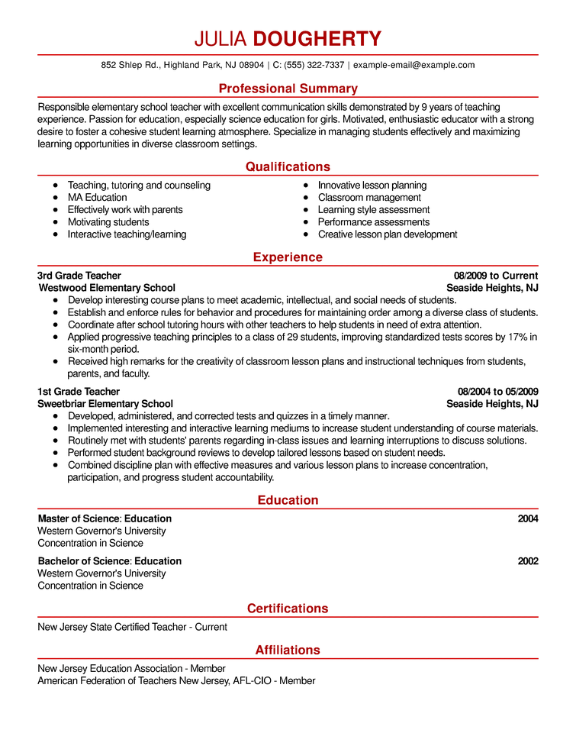

Slide 17
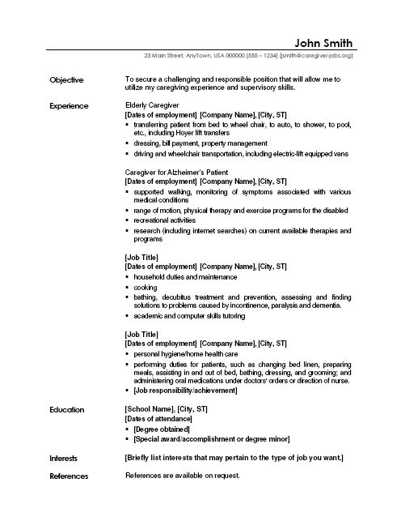

Slide 18
Name and contact information

Slide 19
objective

Slide 20
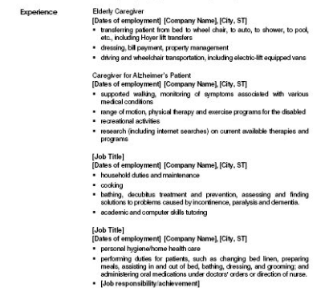
experience

Slide 21
education

Slide 22
Interests/references

Slide 23
Resume tips
1. Different resume formats may be appropriate for different types of jobs.
2. Have ACTUAL references listed.
3. Prepare your resume for a specific audience.
Make sure your resume matches your application!
Keep it simple. You may be asked to give details on what you put down in your resume.
Presentation is important, but don’t overstate the design.

Slide 24
The interview
1. Preparation
2. Dress
3. Punctuality
4. Make an impression
5. Follow up

Slide 25
preparation
1. Where will the interview(s) take place?
2. When is the interview?
3. What types of questions can I expect?
How will I answer?
What COULD come up unexpectedly?
4. Who will be conducting the interview?
How many interviews?
How many interviewees?
What is the position of the interview conductor(s)?

Slide 26
dress
Dress like you want the job! You will be in direct competition with up to hundreds of other candidates, most of whom will be as qualified, or more qualified than you are. You may not be able to set yourself apart in a positive way by how you dress for the interview, but you can CERTAINLY set yourself apart in a negative way.

Slide 27
The interview
1. Nonverbal communication – Stand up straight, make eye contact, connect with a handshake.
2. Listen to what is being said instead of just being ready to say what you prepared.
3. Don’t ramble! Less is more. Often employers will offer the opportunity for you to talk yourself out of getting hired.
4. The interview is not an opportunity to make a new friend. Don’t be too familiar and don’t overstep your boundaries.
5. Watch your language! Cursing, using slang, or remarks that refer to protected topics are not appropriate for interviews.

Slide 28
The interview cont.
6. Be confident, but not overconfident. Professionalism and modesty are good traits to keep in mind.
7. Answer the questions that are asked, not the ones you want them to ask. Be careful to provide a thorough response that answers the question accurately.
8. Ask your own questions. Show interest in the company, and make sure that it will be a good fit for you.
9. Employers don’t have to hire you. Be confident, not desperate. Don’t disclose your financial position, or talk about your needs during the interview.

Slide 29
Questions?

