Slide 1
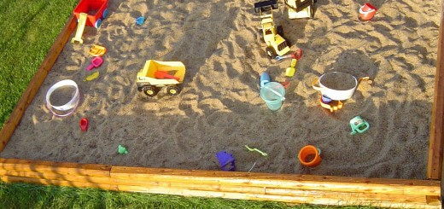
PRE-RESEARCH “SANDBOX”

Slide 2
OVERVIEW
Download the “Pre-Research Worksheet” from douglasteach.weebly.com;
Copy/paste it into MS365 (Word Online), rename it, and share it with me;
PART 1 – Assess credibility of sources to help build ethos in writing (the C.R.A.A.P. Test)
PART 2 – Refine research question/answer;
PART 3 – Build annotated bibliography;

Slide 3
PART 1
Use the (5) sources you summarized for homework and complete a CRAAP test frame to determine the credibility of each;
EXAMPLE: https://books.google.com/books?hl=en&lr=&id=j6cMYKRgqQ8C&oi=fnd&pg=PR5&dq=gun+control+2010&ots=_4cWU9W1iX&sig=38y_v8Pia3_X3G7Y8sZS_F3hy00#v=onepage&q=gun%20control%202010&f=false
CURRENCY | Published 2012, links are active
RELEVANCE | Relates to topic but somewhat tangential to research question
AUTHORITY | Economist, political commentator
ACCURACY | Peer-reviewed, supported with research & evidence
PURPOSE | To persuade, so has some bias, but contains good information
CONCLUSION | CREDIBLE, but MAY not use it due to bias

Slide 4
Where to begin
Scholar.google.com – college-level articles
Supreme Court case histories
http://www.supremecourt.gov/
http://landmarkcases.org/en/landmark/home
Any major news outlet (but remember to read at least 3 different ones to eliminate bias);
EXAMPLES: NPR.org, bbcamerica.com, abcnews.com, msnbc.com, US News & World Report, Time, Newsweek, New York Times, Boston Globe, Phoenix Sun, LA Times, San Francisco Examiner

Slide 5
PART 2
Allow the information from the (5) credible sources to shape/refine your research question.
Check in your question with me.
Remember the guidelines:
Must be researchable and arguable;
Must be able to use evidence from the U.S. Constitution, Supreme Court cases, Bill of Rights;
Question should begin with “why” or “how”, and avoid yes or no;
Question should prompt a thesis that is not too broad or too narrow (see Purdue OWL);

Slide 6
PART 3
Read the gold handout: “Annotated Bibliography”;
Create 5 entries for that bibliography (you may use the summaries you did for homework if the sources are the same).
Each entry contains:
Bibliographic info (link, author, date, source, etc.)
Summary of information in the source
Evaluation (info from CRAAP test)
Application – a note about how you could use the info

Slide 7
Independent Work
Create (5) entries in the annotated bibliography (see gold handout);
This assignment is to be shared with me by Wednesday 2/17/16 11:59 PM (any submissions before 2/16 11:59 PM are ETIC);
Keep adding to the annotated bib (see directions);

Slide 8
Quick Conference
Show me your research question and answer;
Prepare specific questions about your research ahead of time;

Slide 9
READY, SET… GET OUT THERE AND DISCOVER!

