Slide 1
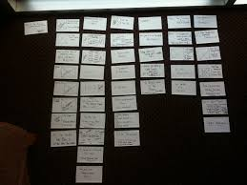
Notecards
Research Paper Project

Slide 2
WHY DID WE COLLECT ALL OF THESE NOTECARDS?

Slide 3
WHAT DO WE DO NEXT?
EVALUATE
SORT
EVALUATE AGAIN

Slide 4
STEP ONE
CREATE 3 SEPARATE STACKS FOR EACH OF YOUR 3 THESIS POINTS.
Sample Thesis: Gabriela Mistral’s work greatly influenced the women of her time by encouraging them to break out of their comfort zone, inspiring them by illuminating the beauty of femininity, and presenting a solid example of feminine power.
Thesis Point 1 | Thesis Point 2 | Thesis Point 3
Encouraging them to break out of comfort zone | Inspiring by illuminating feminine beauty | Presenting a solid example of feminine power

Slide 5
STEP TWO
What’s wrong with this scenario?
Evaluate each notecard for its significance in regard to your thesis points. In other words, sort each card into the category that it supports.
Thesis Point 1 | Thesis Point 2 | Thesis Point 3
Encouraging them to break out of comfort zone | Inspiring by illuminating feminine beauty | Presenting a solid example of feminine power
1
2
3
1
1
1
4
2
2
5
3
3
4
5
Is one quote sufficient evidence to support this claim?
Where do these cards belong?

Slide 6
STEP THREE
Now that you have sorted your cards, ask yourself the following questions:
Do I have enough evidence to support ALL THREE of my thesis points?
Do I need to do more research for any of my thesis points?
Do I need to change any points in my thesis statement?

Slide 7
STEP FOUR
Now that you have sufficient evidence for each thesis point, CHOOSE your 3 best quotes that support EACH of your three thesis points.
Thesis Point 1 | Thesis Point 2 | Thesis Point 3
Encouraging them to break out of comfort zone | Inspiring by illuminating feminine beauty | Presenting a solid example of feminine power
1
1
1
2
2
2
3
3
3

Slide 8
STEP FIVE
Flip over each note card you chose for support, and
write a few sentences answering these questions:
1) So what?
2) Why is this quote significant?
3) How does this quote support what I am trying to prove in my thesis?

Slide 9
EXAMPLE
“A dedicated educator and an engaged and committed intellectual, Mistral defended the rights of children, women, and the poor…not only in Latin America, but in the whole world.”
1) So what?
2) Why is this significant?
3) What do you think this student is trying to prove? What is a possible thesis statement?

Slide 10
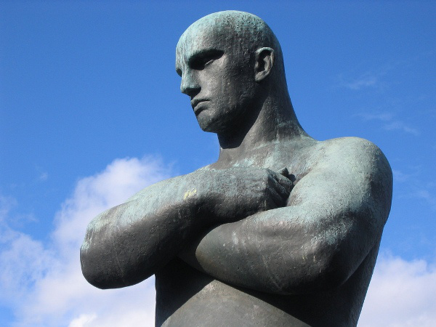
ACTIVITY: DEFENDING YOUR POSITION
With a partner at your table, take 2-minute turns arguing one of your thesis points.
Partner A states thesis and supporting quote.
Partner B: “Defend your first point.” (crosses arms)
Partner A explains why the point is significant, and how the quote supports the thesis.
Partner B challenges with “So what?”
Partner A continues the defense until Partner B is convinced. Partner B unfolds arms to indicate persuasion.
If Partner B is not convinced at the end of the timed persuasion, give feedback to Partner A.

Slide 11
REFLECT (exit ticket)
How did this exercise “re-shape” your outline and/or your thesis?
What is your next step in this process? Explain.

