Slide 1
Revising Topic Outlines

Slide 2
OVERVIEW
Parallelism, Division, Coordination, Subordination
Topic Sentence, transition, echo practice
Effective Topic Sentences

Slide 3
Exercise 1 – identify the topic sentence, transition words, and echoes
1. a. He won Rookie of the year in 1947. b. He broke the color barrier in professional baseball. c. He excelled despite encountering racist players, managers, and fans and receiving death threats. d. Jackie Robinson single-handedly brought equality and civil rights to professional sports.

Slide 4
Answer - 1
1. a. He won Rookie of the year in 1947. b. He broke the color barrier in professional baseball. c. He excelled despite encountering racist players, managers, and fans and receiving death threats. d. Jackie Robinson single-handedly brought equality and civil rights to professional sports.

Slide 5
Exercise 1 – identify the topic sentence, transition words, and echoes
2. a. There are two primary approaches to learning a foreign language. b. First, there is the textbook approach of understanding the grammar and linguistics while studying vocabulary. c. Second, there is immersion in a foreign language, either in a school or in a foreign country where the language is spoken. d. Ideally, learning a foreign language involves a combination of both methods.

Slide 6
Answer - 2
2. a. There are two primary approaches to learning a foreign language. b. First, there is the textbook approach of understanding the grammar and linguistics while studying vocabulary. c. Second, there is immersion in a foreign language, either in a school or in a foreign country where the language is spoken. d. Ideally, learning a foreign language involves a combination of both methods.

Slide 7
Exercise 1 – identify the topic sentence, transition words, and echoes
3. a. Did I come to Venice to see the beautiful St. Mark’s Basilica? b. Am I here to walk across the elegant white stone Bridge of Sighs? c. The main reason I am in Venice is to learn to pilot a gondola. d. A gondola is the traditional boat taxi of Venice’s canals. e. It has a low hull and a steel prow and is rowed by a gondolier who wears an old-fashioned striped shirt and steers with a long oar.

Slide 8
Answer - 3
3. a. Did I come to Venice to see the beautiful St. Mark’s Basilica? b. Am I here to walk across the elegant white stone Bridge of Sighs? c. The main reason I am in Venice is to learn to pilot a gondola. d. A gondola is the traditional boat taxi of Venice’s canals. e. It has a low hull and a steel prow and is rowed by a gondolier who wears an old-fashioned striped shirt and steers with a long oar.

Slide 9
Persuasive Topic Sentences
The topic sentence often does not appear at the beginning of a sentence if the piece of writing is persuasive. Instead, the first sentence would be some kind of a lead sentence or a hook.
It is always a good idea to capture your reader’s attention as quickly as you can, but it is even more important to engage it immediately in a persuasive piece. Here are three recommended types of lead sentences.

Slide 10
Effective Lead Topic Sentence Types
Startling statistic
Quote*
Rhetorical question
*this generally doesn’t mean quotes from your notecards – or, if it does, remember to set it up!

Slide 11
STARTLING STATISTIC
If you can find a statistic about your topic that will make your readers interested right away, then you have a good lead. It is ineffective if you use a statistic that does not provoke them to think. (logos & pathos)
Example: In the roaring twenties, 30% of the money in the United States was controlled by 5% of the richest families.

Slide 12
Quote
For a persuasive piece, you can take a quote from your source and use it as your lead.
Example: The governor, in his speech about water rights, called the attempts to limit consumption “a waste of the taxpayers’ time and effort.”
Notice the introductory info framing the quote.

Slide 13
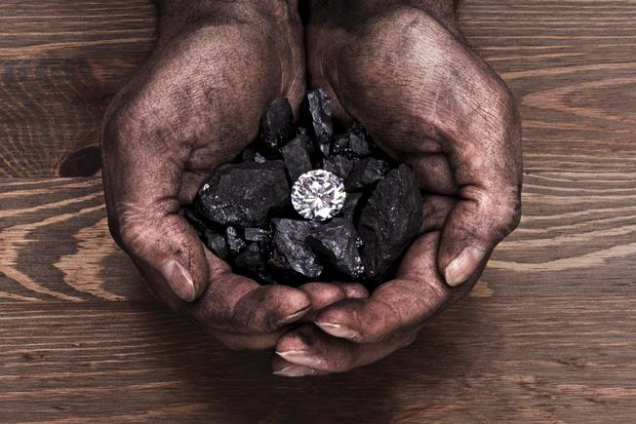
QUOTES - REMEMBER!
Don’t leave the diamond in the dirt!
ALWAYS remember to SET UP your QUOTES with INTRO information, and OUTRO them with analysis;

Slide 14
RHETORICAL QUESTION
A rhetorical question is a question that does not necessarily need an answer, and is used by writers or speakers to persuade their audience to agree with an argument, or to raise a provocative issue. The answer to such a question is usually obvious, and does not need to be stated, but you may choose to provide an answer at a later point in your paper.
CAUTION: If you are writing an academic paper, it is usually not acceptable to use the second person “you,” as in “Have you ever wondered how many stars there are in the night sky?”
Example: Did the invention of barbed wire really change the pace of the westward movement?

Slide 15
SUPPORTING SENTENCES
Since the topic sentence states the main idea of the paragraph, the supporting sentences must give enough information to develop that main idea clearly.
A good, solid paragraph has at least two supporting details.
A specific topic sentence serves to direct both the writer and the reader toward specific supporting details.
Thesis = topic sentence of the essay
Topic sentences = supporting sentences of thesis
Supporting sentences = evidence supporting topic sentences

Slide 16
SUPPORTING SENTENCES - example
Example: There are different stances used when hitting a baseball (topic sentence).
One stance involves keeping weight on the back foot and striding into the pitch.
This swing is generally designed for power (supporting sentences developing the first idea).
Another swing is called the “weight shift swing.” Both of the batter’s feet remain on the ground and the batter’s weight shifts as the bat comes through the strike zone.
This swing is designed for contact hitters, as it tends to keep the bat level and allows the batter to hit to any field more easily (supporting sentences developing the second idea).

Slide 17
SUPPORTING SENTENCES: sensory details
Some paragraphs are best developed using details from the five senses: taste, touch, sight, sound, and smell. These sensory details can support a topic sentence.
Example: The police arrived at the home of the alleged dog abuser. It smelled bad and the kennels were cold and dirty. The dogs were neglected.
Edited Example: The police arrived at the home of the alleged dog abuser and found the smell overwhelming. The dogs had not been let out of their kennels for days, and they had no clean place to lie down and no food or water. The generator used to heat the kennels emitted a piercing whine but no heat. Clearly, this was a case of animal neglect.

Slide 18
SUPPORTING SENTENCES: quote, analysis, facts, reasons, examples, details, statistics
Your most important role in supporting sentences is to support your thesis;
Within that goal, you MUST include a QUOTE AND ANALYSIS – don’t leave the “diamond in the rough”- set it up and analyze it!
Facts, statistics, and specific examples can also be used to develop your paragraphs.
When you revise, look for paragraphs that seem weak and lack solid evidence. You may have to do some more research to find information, but your paragraphs need to have enough information to deliver on their promise of supporting the topic sentence, and ultimately, the thesis.
An anecdote or incident can tell a lot about a subject as well. An anecdote is a short story—often humorous—about an attention-grabbing event. Anecdotes can be very effective in making the reader visualize and identify with your main idea.

Slide 19
OUTLINE REVISIONS
Revise your TOPIC OUTLINE for the following:
PARALLELISM – Check to see that your ideas and sentence structure are parallel throughout the outline.
Are the ideas parallel?
Do the ideas in each paragraph support the thesis statement (echo)?
Are the sentence structures parallel?
COORDINATION – Check to see that your ideas coordinate well (not too different)
Are the ideas balanced in their similarities and differences? If not, how could they be revised?
Are there transitional phrases (see reference doc on website) between ideas and paragraphs?
Are concessions and evidence evenly balanced, or is there bias?
DIVISION – check to see that your ideas don’t overlap (too similar)
Do any ideas overlap?
Can you combine ideas to create a more complex idea / analysis?
SUBORDINATION – ideas are organized
Does the intro paragraph give context/background to each idea in the thesis?
Do you have an effective hook/clincher statement?
Are the ideas structured in a particular order (chronological, spatial, order of importance, etc.)?
Can you revise to improve the order of your ideas?

Slide 20
OUTLINE REVISIONS
CITATIONS – ideas are credited
Are your quotes complete with citations of sources from your notecards, (which includes the author, the page number, and the source #)?
Does the source exist in your ANNOTATED BIBLIOGRAPHY?
ANALYSIS – your evidence speaks through YOUR voice
Are each of your quotes followed by at least 3-4 analytical thoughts that tie them to the thesis?
Could you include more depth in your analysis?

